Slide 1
Reproducing Production Issues in your CI Pipeline Using eBPF
Omid Azizi, New Relic/Pixie
Matthew LeRay, Speedscale
May 19, 2022

Slide 2






Hi
Omid Azizi @oazizi Principal Engineer, New Relic
Founding Engineer, Pixie
Matthew LeRay @matthewleray Co-founder, CTO Speedscale
Notes:
This slide is for marketing + promoting your talk! Please select the appropriate slide for your talk type: Two-speakers, One-Speaker or Panel + add your talk and speaker details to the slide. To add a photo(s): Right click on the image placeholder and select replace and upload a photo. You can then save the individual slide as an image to use when tweeting or sharing on LinkedIn or Facebook. Please email cncfcolocatedevents@cncf.io if you have any questions.

Slide 3
The Challenge with Testing
We’ve all been there: You make a new release, and prod is broken. 😱
What’s going on?
Did we break some API that’s not tested?
Is it a performance issue?
Could we have prevented this with more test data? 📊

Slide 4

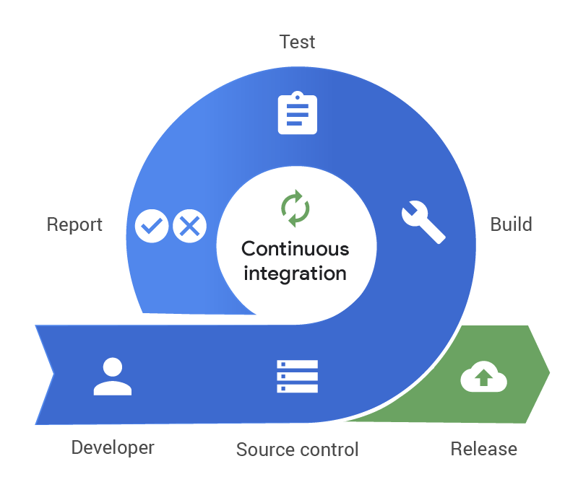

Why Traffic Replay?
Treat your tests like cattle, not pets
Developer Desktop
CI Pipeline
Production
Traffic
(refreshed continuously)

Slide 5



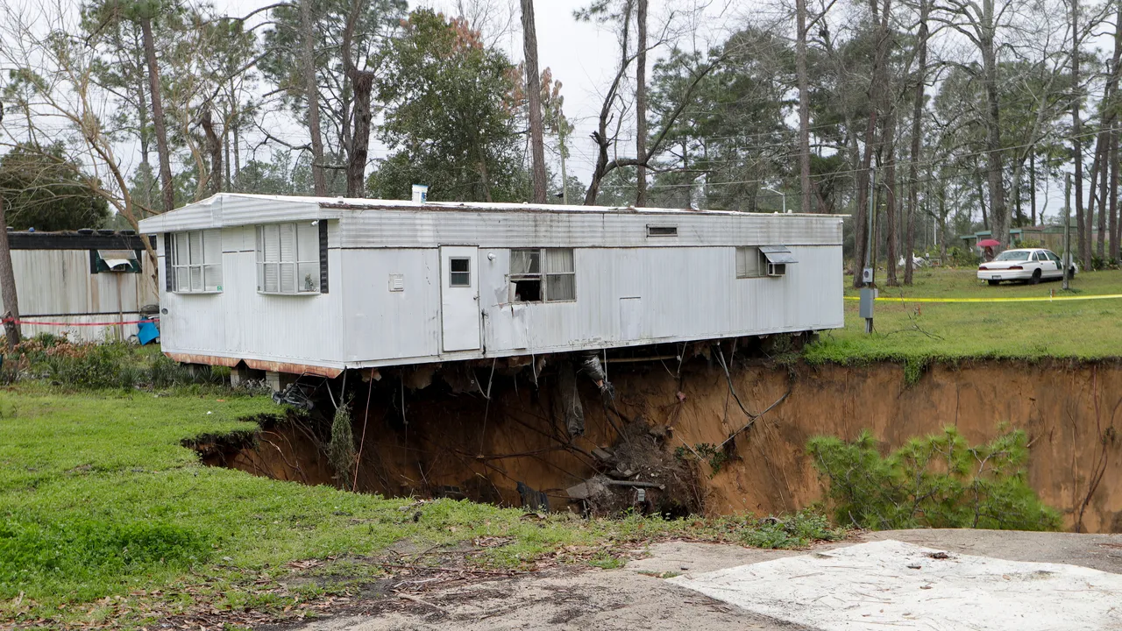
Ways to Replay Traffic for Testing
Prod
(or only test in prod)
Traffic Mirroring
Traffic Replay
payment
payment
payment
gateway (candidate)
gateway
gateway
Production
Production
Production
user
user
user
gateway
(primary)
…
gateway
(secondary)
payment
…
gateway
Pre-prod CI
YOLO
user
load
generator

Slide 6
Replay begins with Record
If we want to replay production traffic, we must first capture the data.
What are the microservices saying to each other?
How can we capture the K8s pod traffic unobtrusively?
payment
gateway
Production
Capture traffic
user

Slide 7


Meet Pixie: eBPF-based tracing on K8s
Pixie: An open-source CNCF observability platform
Automatically traces network messages, provides CPU profiles, etc.
Pixie’s philosophy: No manual instrumentation
No code modifications
No redeployments
How is this possible?
Powered by

Slide 8
What is eBPF? An Analogy
An eBPF probe is like a breakpoint in a debugger.
Interrupts execution when breakpoint is reached.
But unlike a breakpoint, a small eBPF program runs
Application Code
eBPF Code
void ProcessReq(Req r) {
if (r.body == "ping") {
SendPong(r);
}
...
}
// Small probe
// counts number of
// calls to SendPong()
int ProbeSendPong() {
pong_count++;
}
probe

Slide 9
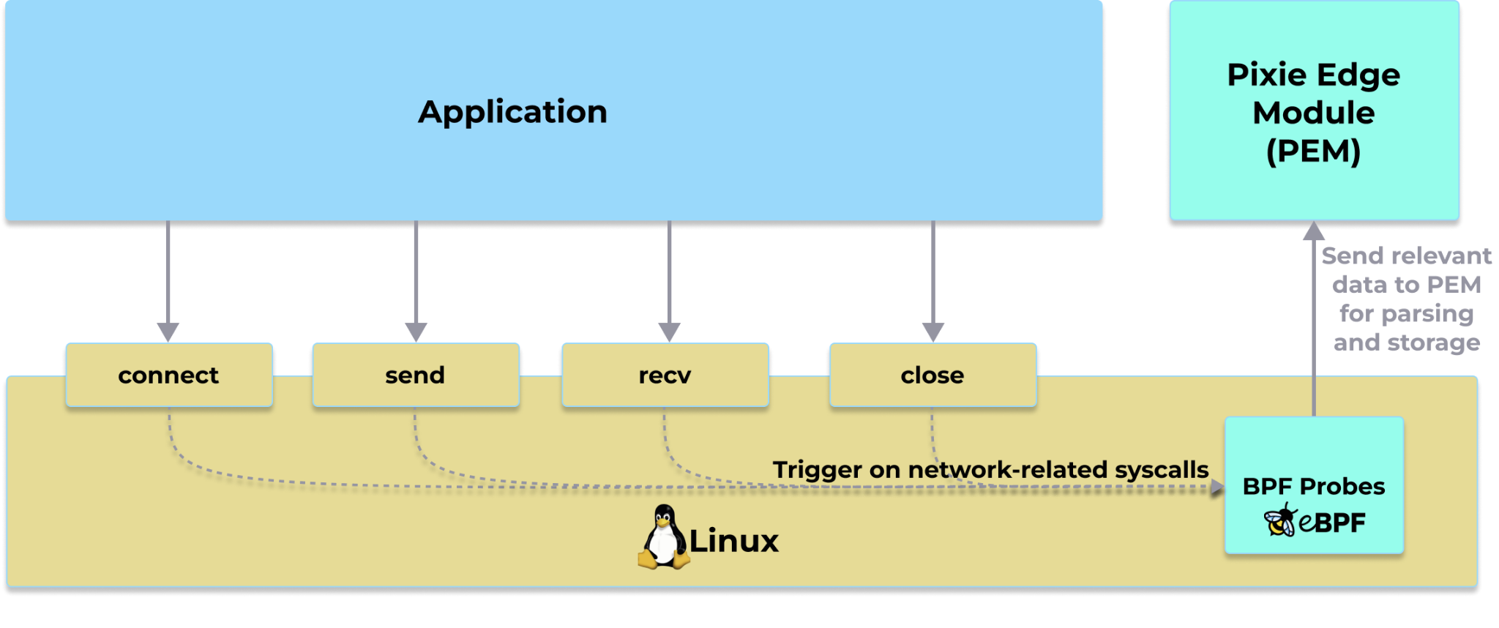
Pixie’s Protocol Tracer
Snoop messages at the kernel syscall.
Covers all traffic → reduce blind spots.

Slide 10
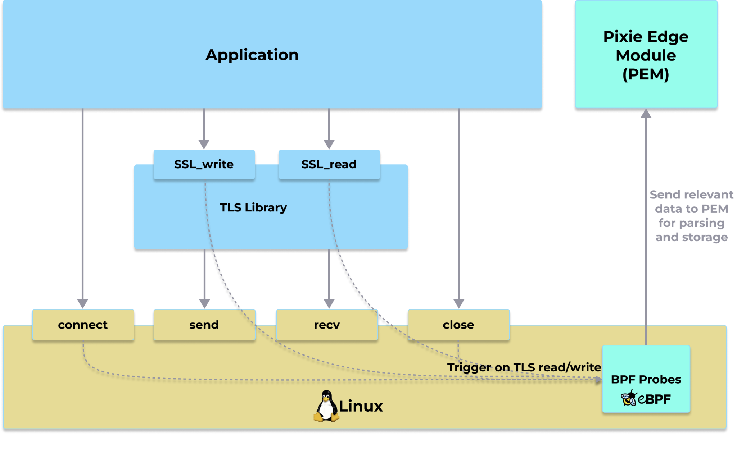
What about TLS traffic?
Pixie and the power of eBPF have you covered.
Pixie probes the TLS libraries to trace the unencrypted traffic.
Currently supported TLS libraries:
OpenSSL
Golang TLS

Slide 11
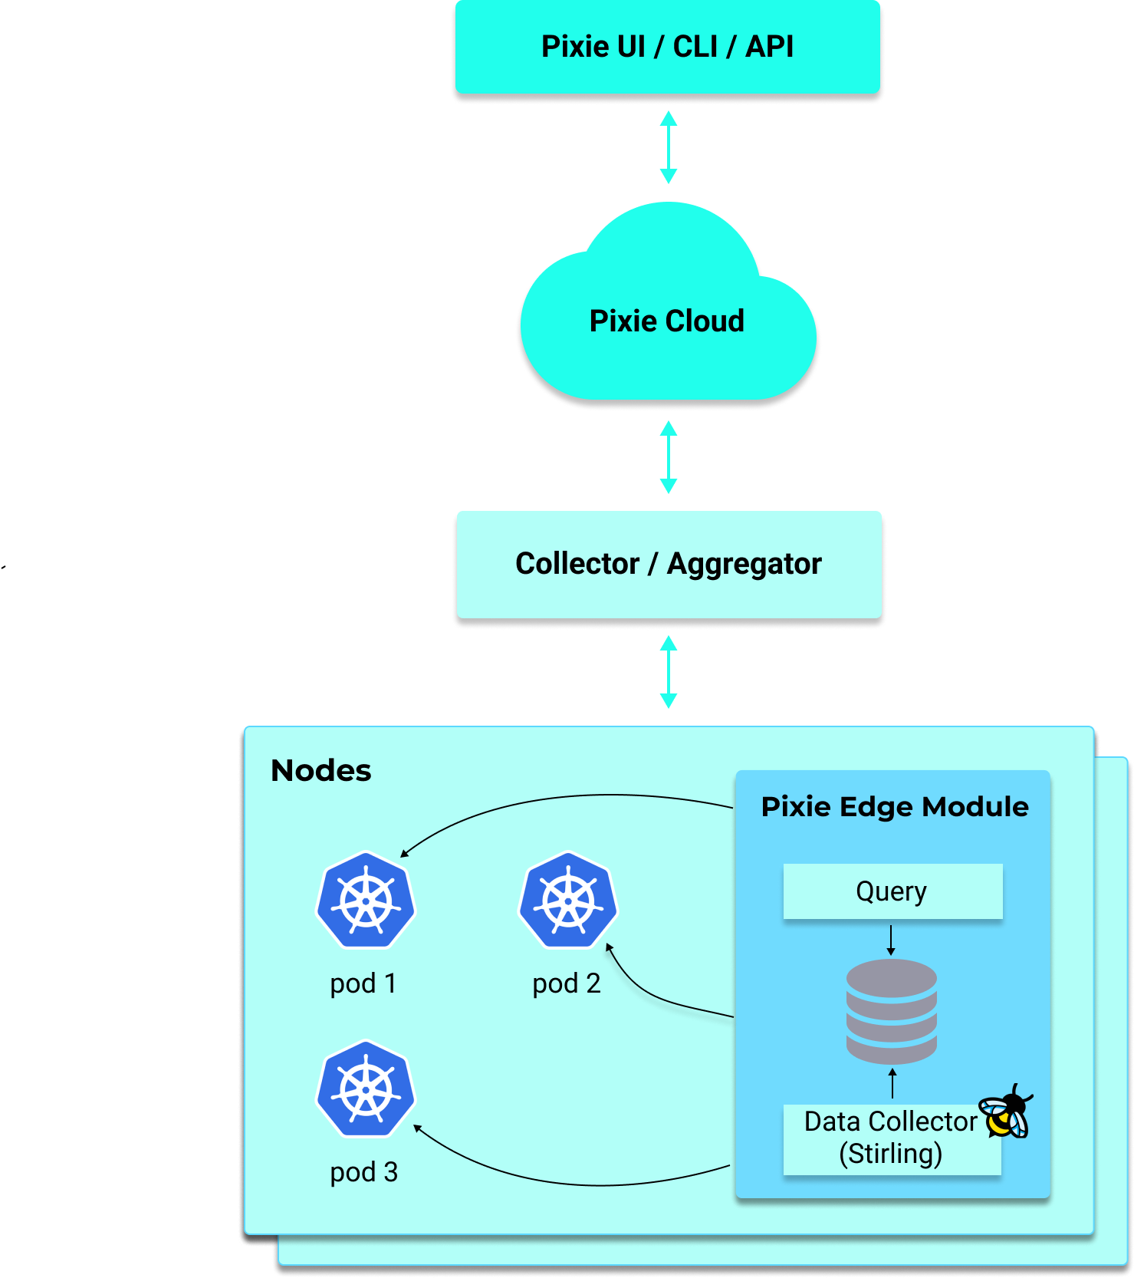
Pixie Architecture
Pixie Edge Module (PEM) deploys on every node.
Captures traffic with eBPF.
Stores data into tables for querying.
Characteristics:
Zero-instrumentation: No manual work
Distributed architecture & in-memory data store.
Scriptable Pandas interface for querying data.

Slide 12
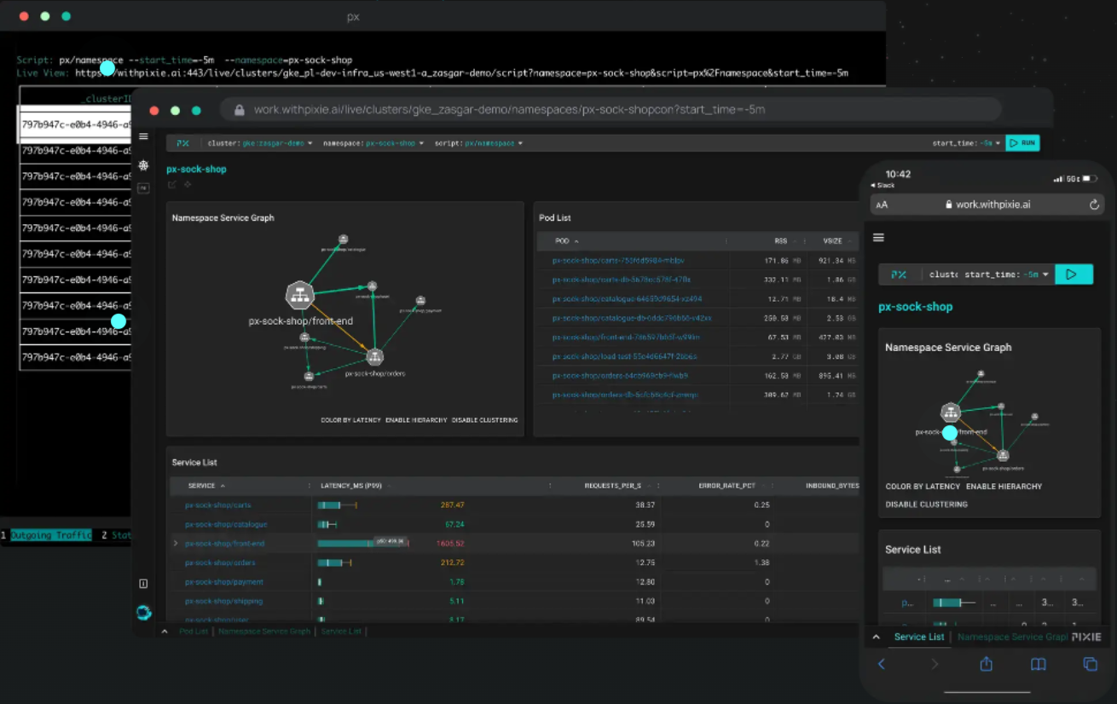

Title
Demo of Pixie

Slide 13
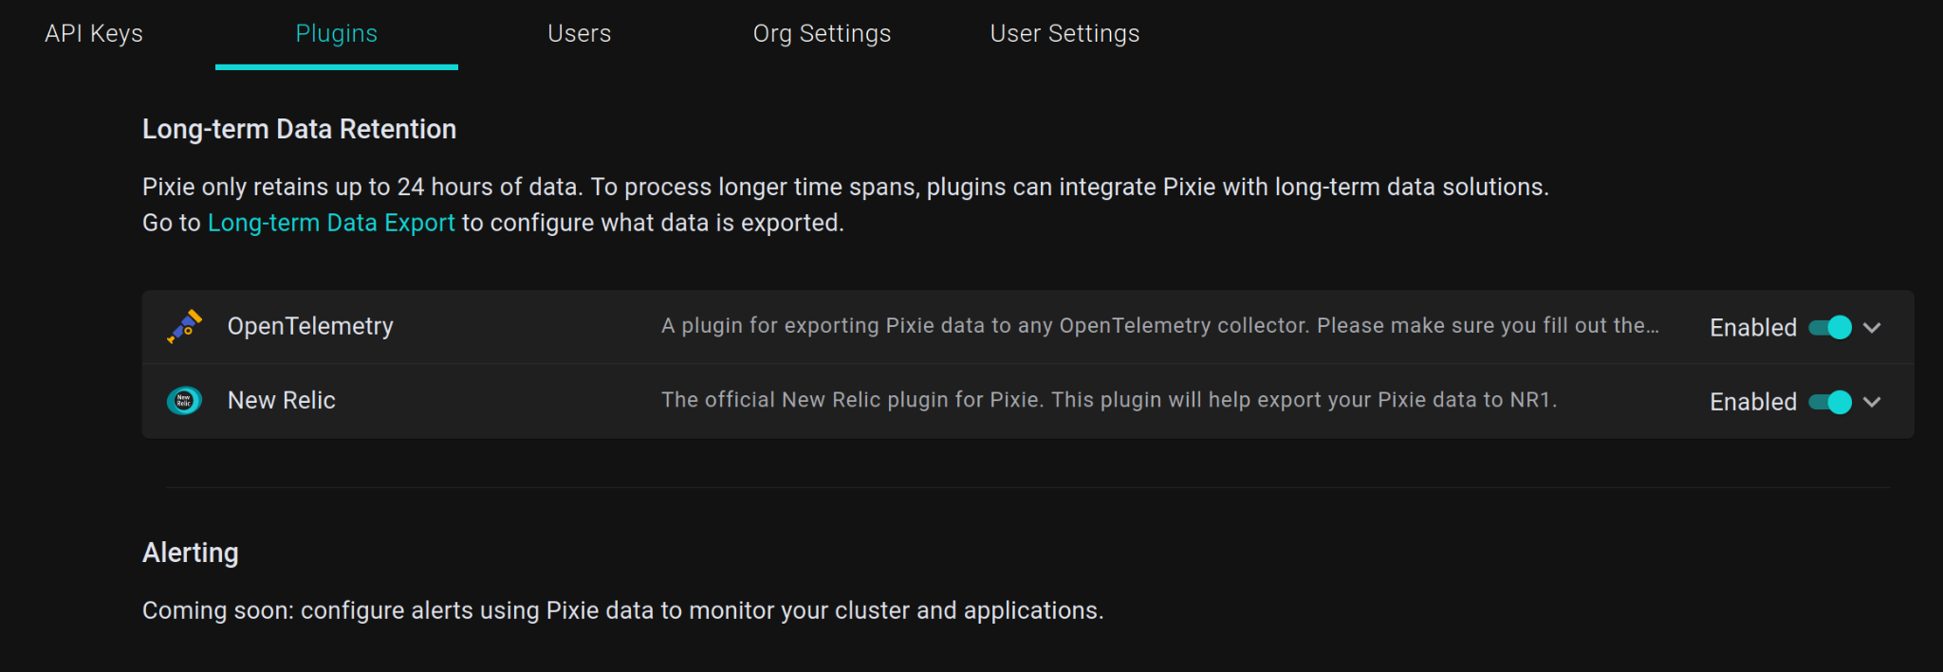
Integrating with Pixie
Approach
Input: PxL script to specify data of interest.
Output: Data!
Two options:
Pixie API (gRPC)
Pixie Plug-in System

Slide 14
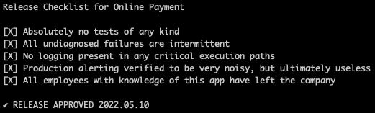
Title
CI Demo Use Cases (with Code)
Online Ordering App
payment
Curl script
gateway
Github CI
user
Test the API contract of a new version of a service
Make sure the new version of a service isn’t radically slower than an old one
https://github.com/speedscale/demo

Slide 15
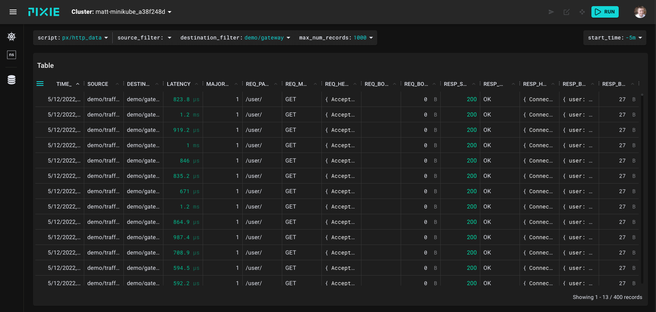
Requests we want to replay

Slide 16
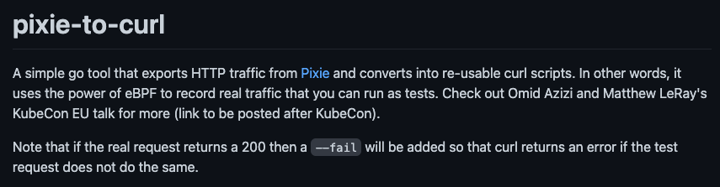
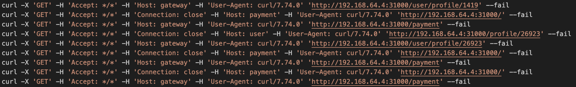
Title
Converting recordings into curl commands
https://github.com/speedscale/pixie-to-curl
https://docs.pixielabs.ai/using-pixie/api-quick-start/

Slide 17
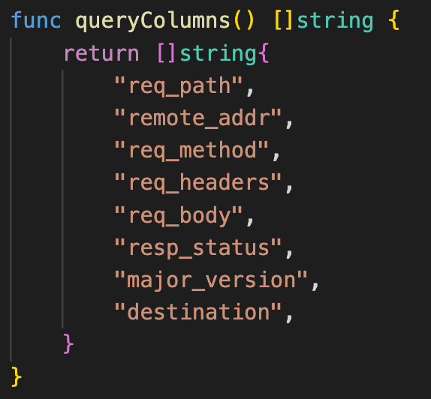
Filter the data

Slide 18
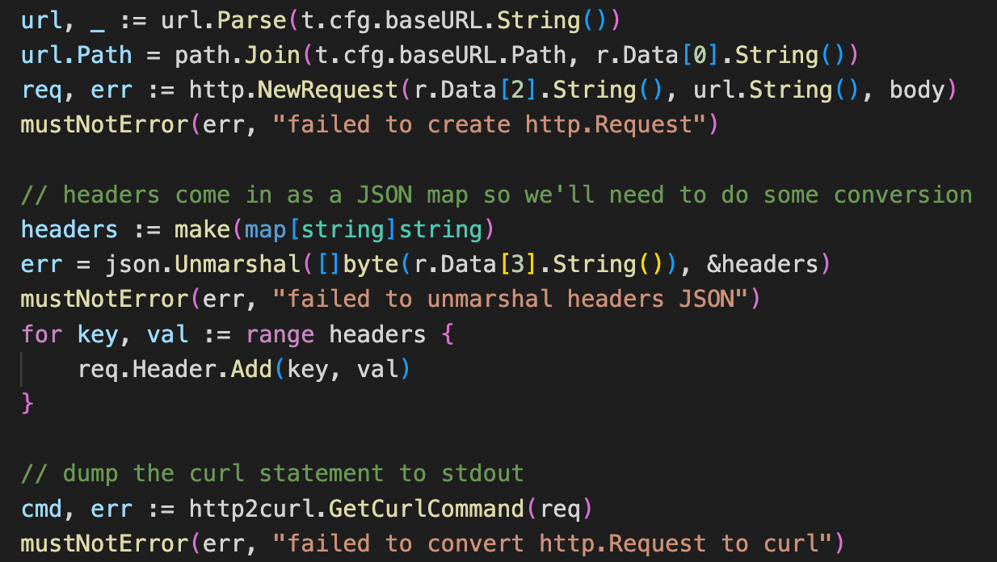
Convert Pixie API -> curl commands

Slide 19
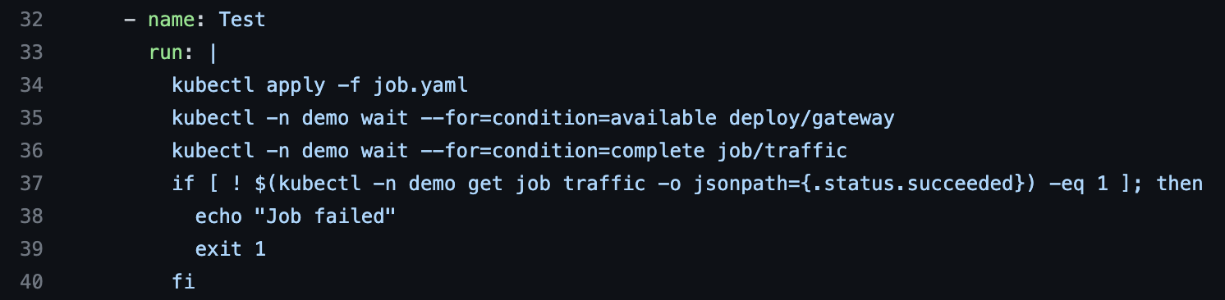
Title
Adding recurring tests to Github Actions
Pick a Kubernetes cluster to run CI in
Add workflow step to .github/workflows/main.yaml
3. Full example here: https://github.com/speedscale/demo/blob/master/.github/workflows/main.yaml

Slide 20
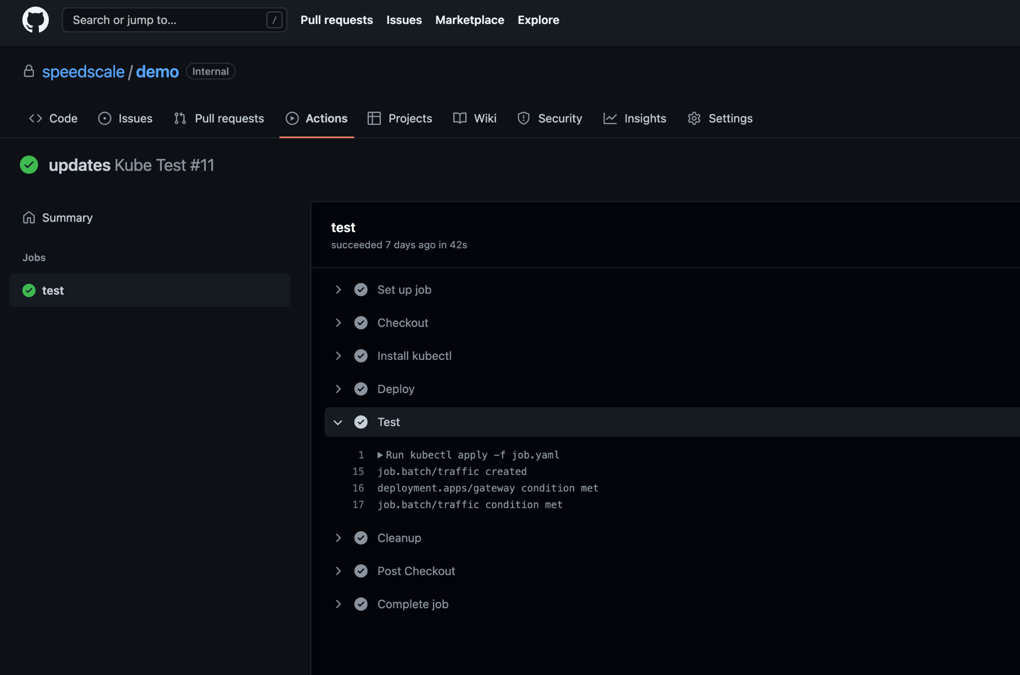

Slide 21

Title
Demo 1: Can I safely change this API?
Notes:
Image Credits:
https://twitter.com/thepracticaldev/status/720257210161311744

Slide 22
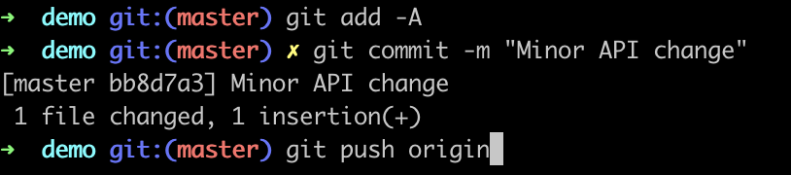
Break the API

Slide 23
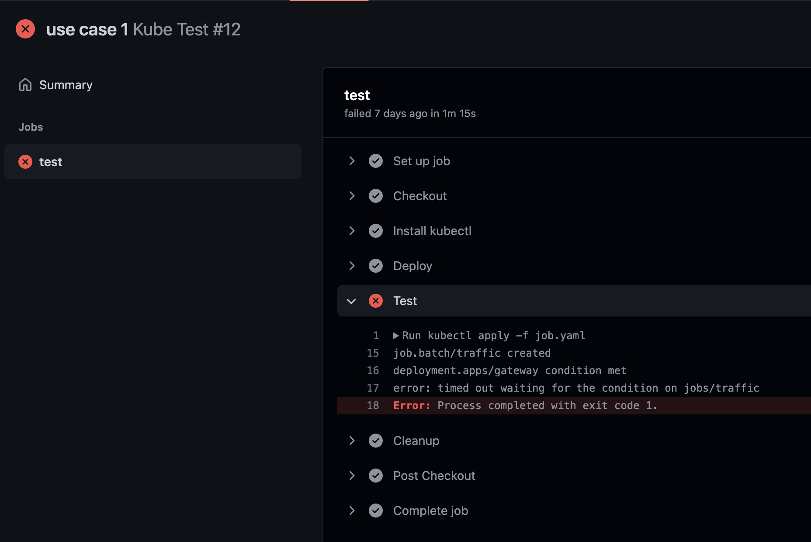
Traffic Replay catches the error

Slide 24
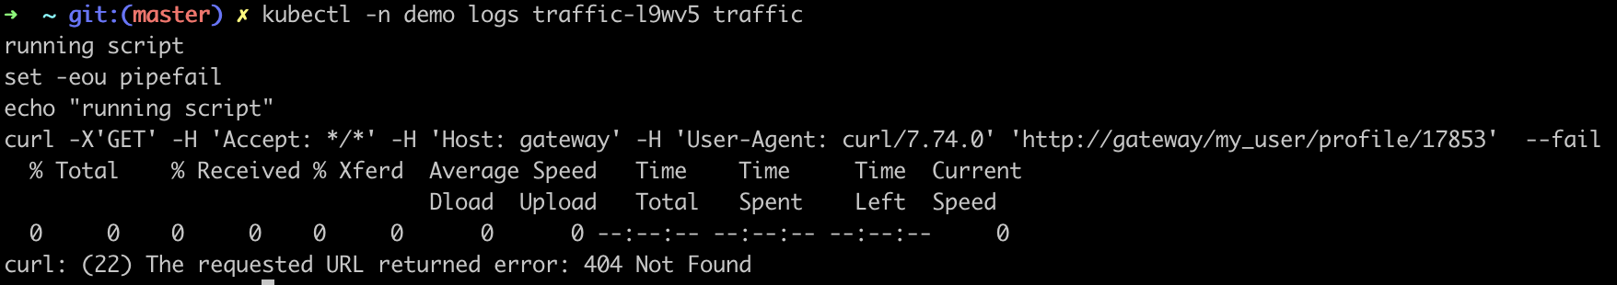
What happened?

Slide 25
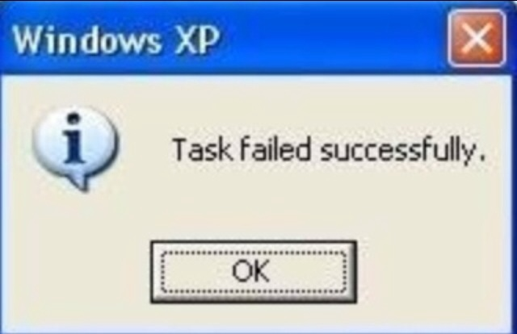
Title
Demo 2: Can my new version handle high load?
Notes:
Image credits:
https://medium.com/swlh/the-ten-most-ridiculous-error-messages-in-the-history-of-software-4198d710ea8e

Slide 26
Title
Demo 2: Can my new version handle high load?
Open job.yaml and add this line:
parallelism: 100
Commit
Check github actions

Slide 27
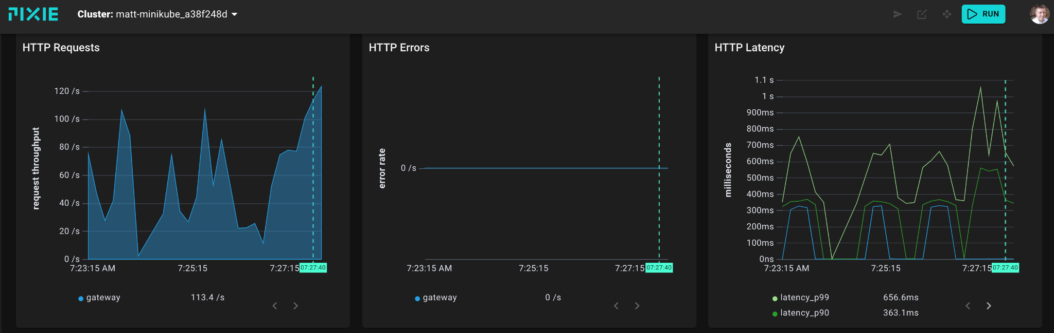
Did it fall over? Not really, it just slowed down

Slide 28

Title
Real Apps Are More Complex
3rd party APIs
Databases
Non-idempotent transactions
Data privacy and security
Authentication
Data transformation like date ranges
Payload sizes and data volume
Checking payload contents
Notes:
Image Credits:
http://www.quickmeme.com/meme/3oka26

Slide 29

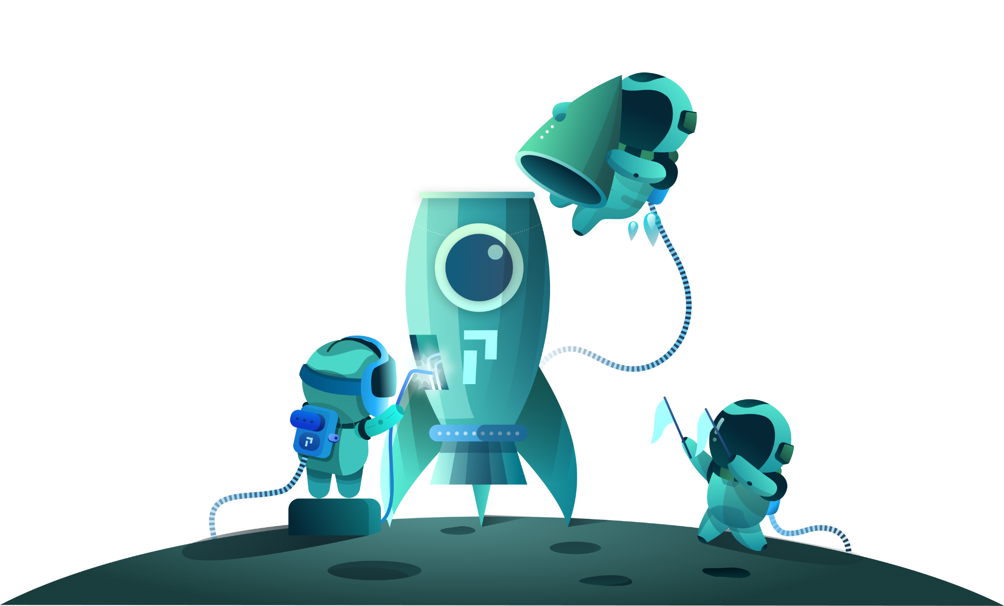
For more on Pixie…
Website: px.dev
Github: pixie-io/pixie
Also visit us at the project pavilion!

Slide 30
Title
Thank you!...Questions?
Further Reading
https://engineering.fb.com/2021/10/20/developer-tools/autonomous-testing/
https://blog.twitter.com/engineering/en_us/a/2015/diffy-testing-services-without-writing-tests
Pixie-to-curl: https://github.com/speedscale/pixie-to-curl
Notes:
You forgot to turn off your Slack one night and now you are responsible for the most important service at the company that no one understands…payment
Of course, there are no tests.
Will your recent bug fix break something else?

